Slide 1

Environmental Effects
on Galaxy Evolution
Ziqi Mu

Slide 2
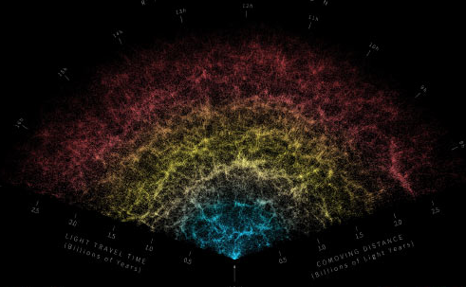
Background Information
Galaxies are distributed in a web-like structure that can be classified into clusters, filaments, walls, and voids.

Slide 3
Why We Care
We use 𝐒𝐃𝐒𝐒 𝐃𝐑𝟕 galaxy catalog and aim to understand how galaxies evolve in different environments. Specifically, we focus on galaxy properties in voids and outside of voids.
Void galaxies are anticipated to evolve more slowly than those in denser areas.
Therefore, we aim to observe these differences in the observable properties of galaxies in different environments and hope to deepen our understanding of the universe's structure.

Slide 4
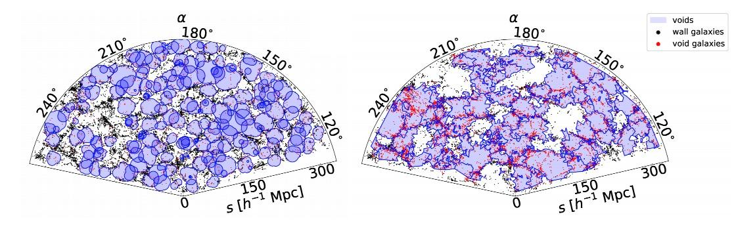
Void Algorithms We Use
There are two popular void-finding algorithms: 𝐕𝐨𝐢𝐝𝐅𝐢𝐧𝐝𝐞𝐫 (𝐕𝐅) and 𝐕²
𝐕𝐨𝐢𝐝𝐅𝐢𝐧𝐝𝐞𝐫 (𝐕𝐅)
Assumes voids are spherical
Relies on several tunable parameters
𝐕²
Makes no assumptions regarding the shape of voids
Depends on fewer tunable parameters
Any galaxy falls within the void regions defined by a given algorithm is considered a void galaxy; all others are classified as wall galaxies.

Slide 5
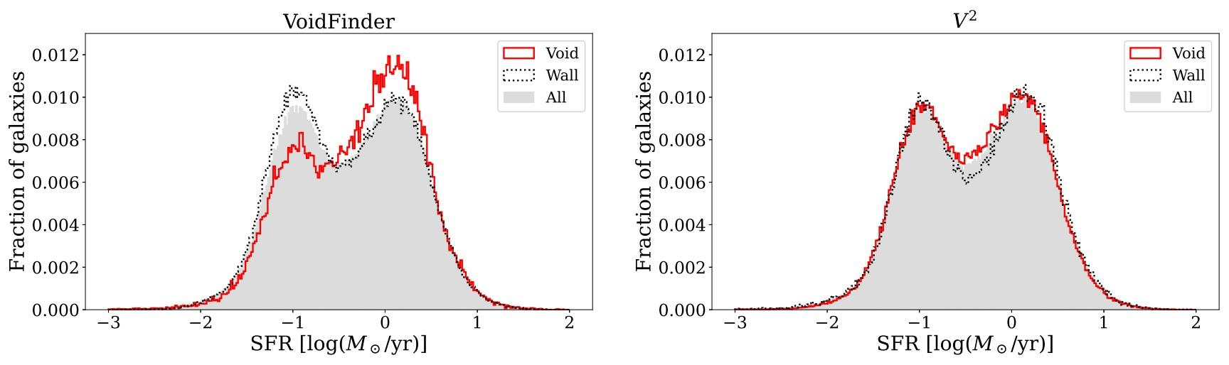
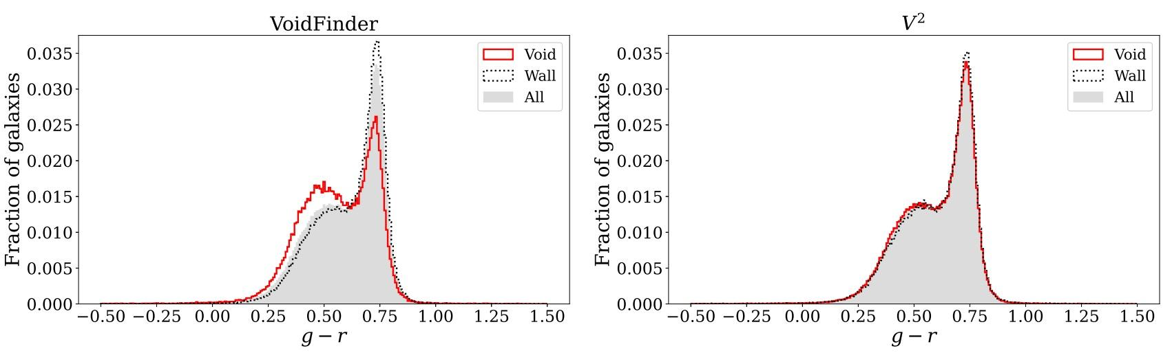
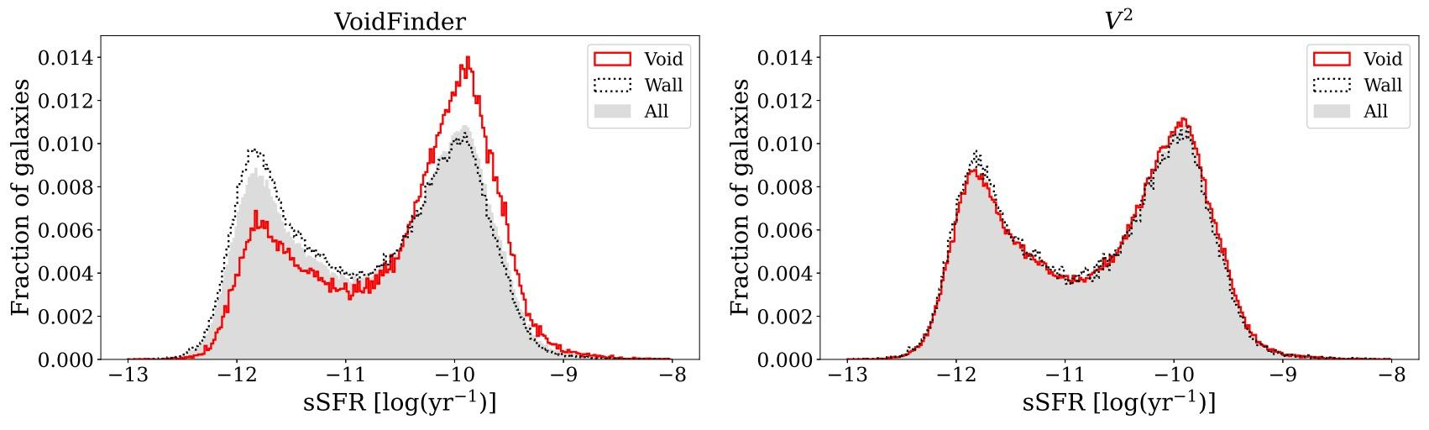
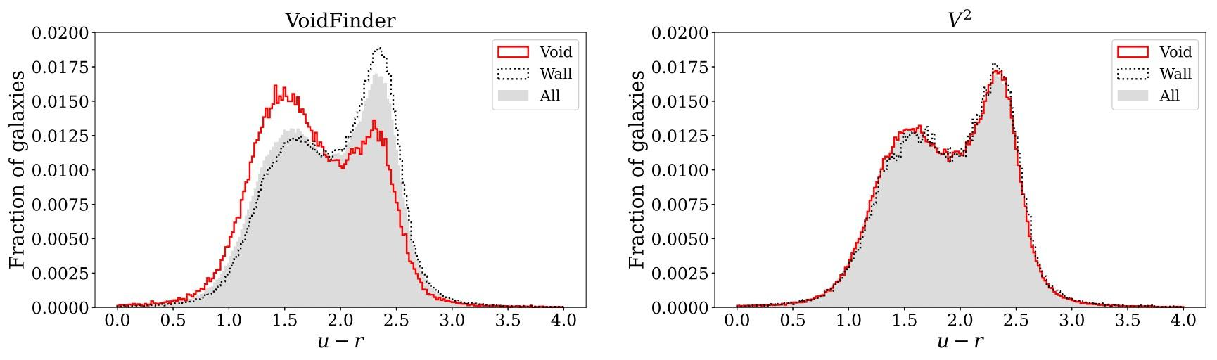
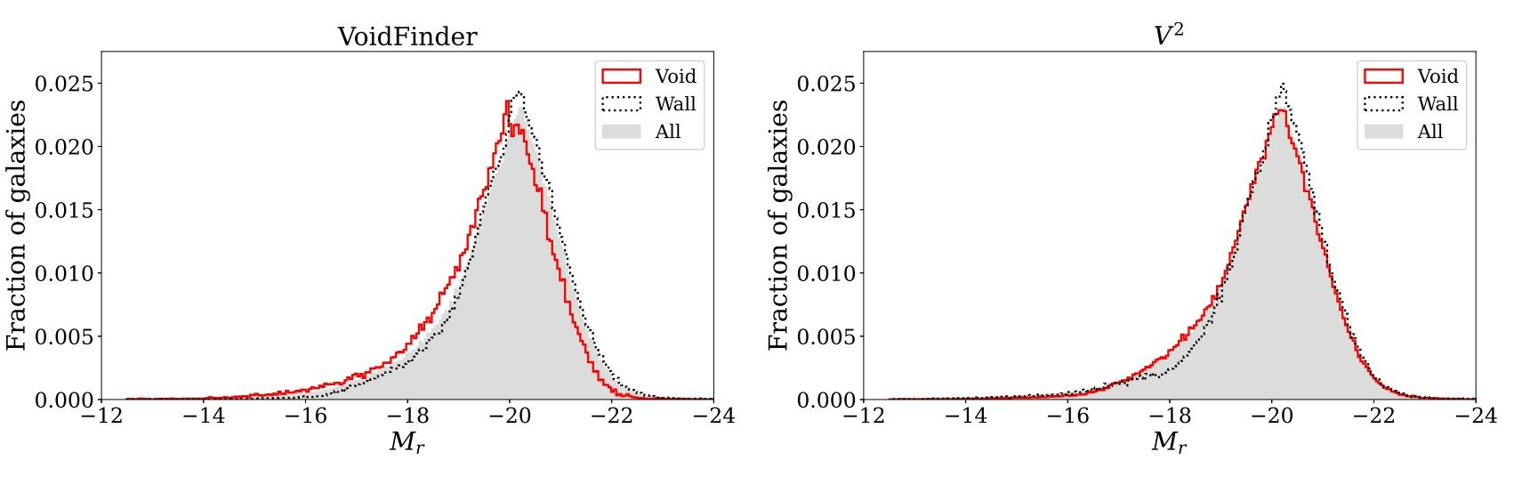
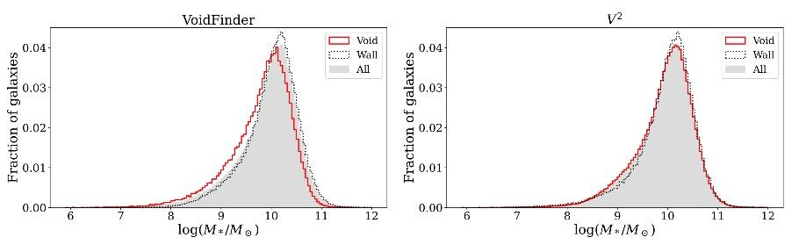
Observable Galaxy Properties: Walls vs Voids
We look at six properties: stellar mass, absolute magnitude, star formation rates (SFR), specific star formation rates (sSFR), color distribution u-r, and g-r

Slide 6
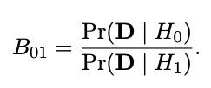
Nonparametric Bayesian Test
Bayes Factor:
Given data D, the Bayes Factor is the ratio of the marginal likelihoods given each hypothesis. It measures the strength of the evidence against the null hypothesis H₀
Value of B₀₁ | Value of log(B₀₁) | Evidence against H₀
1 to 0.32 | 0 to -1/2 | Not worth more than a bare mention
0.32 to 0.1 | -1/2 to -1 | Substantial
0.1 to 0.01 | -1 to -2 | Strong
< 0.01 | <-2 | Decisive

Slide 7
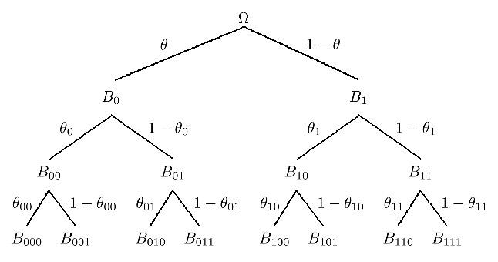
Nonparametric Bayesian Test
Bayes Factor can be calculated using the Pólya Tree, which is a nonparametric prior distribution that constructs probability distributions through recursive partitioning
𝞱: probability of turning left, ~𝑩𝒆𝒕𝒂(𝞪₀, 𝞪₁), where 𝑩𝒆𝒕𝒂(𝞪₀, 𝞪₁) = Γ(𝞪₀) Γ(𝞪₁) / Γ(𝞪₀ + 𝞪₁)
𝞪: constant at level 𝞪₀ = 𝞪₁ = 𝒄𝒎²
𝒎: depth of the tree
𝒄: free variable, ideally between 1 and 10. A larger 𝒄 reduces variance, forcing distributions more similar

Slide 8
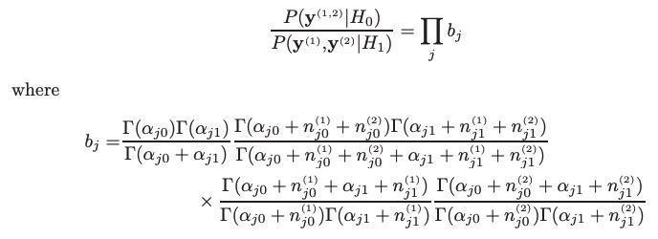
Nonparametric Bayesian Test
Bayes Factor can be calculated as
Notes:
use Python to implement these formulas

Slide 9
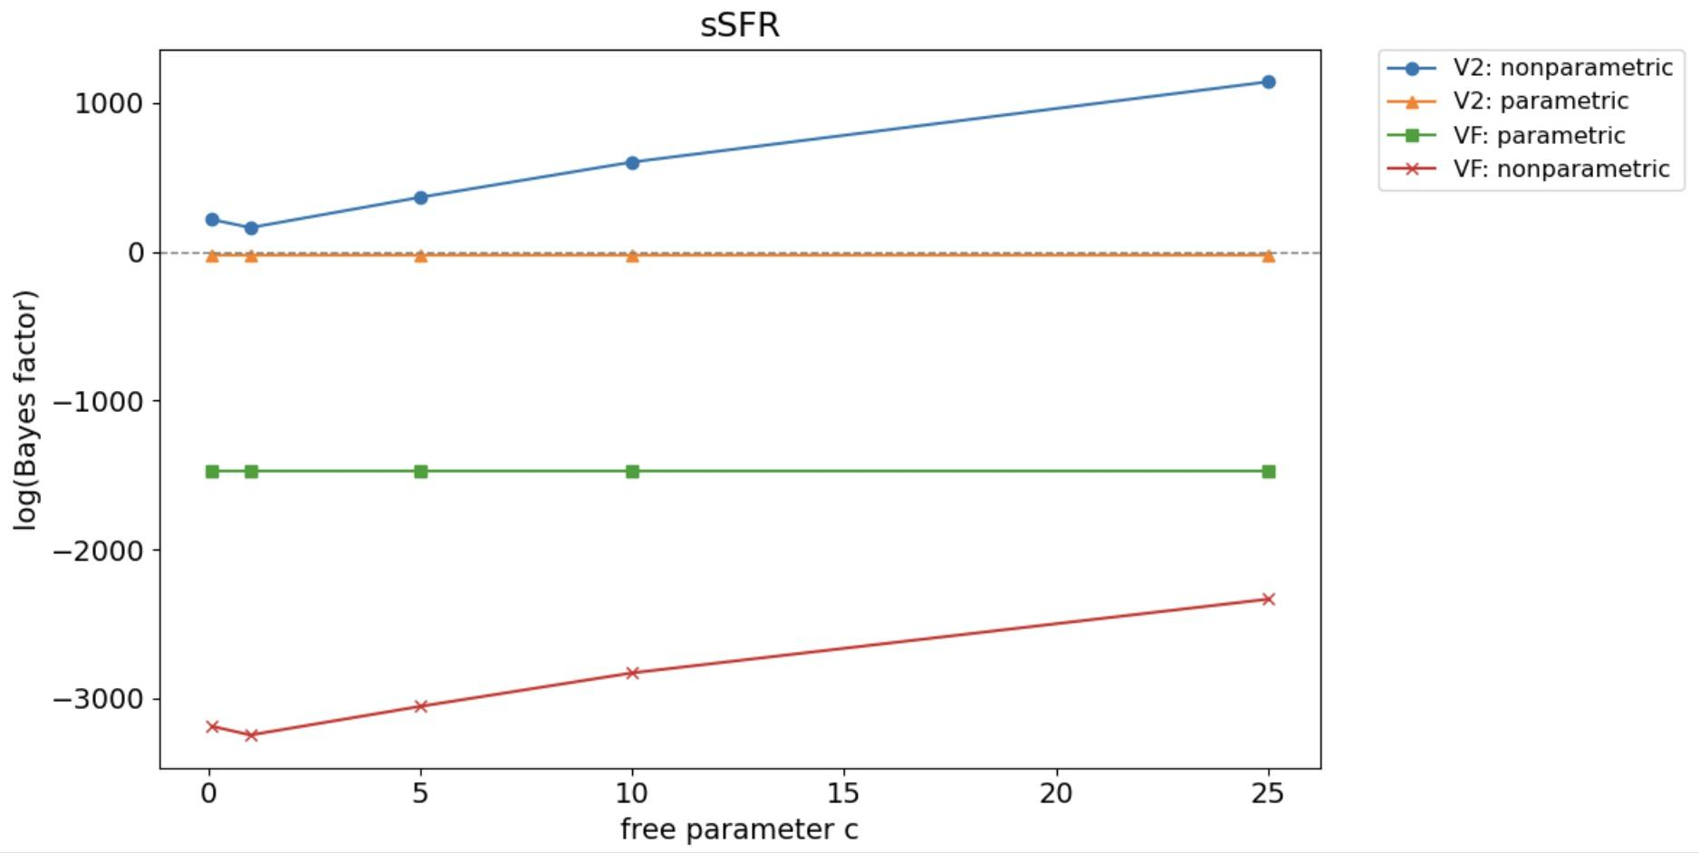
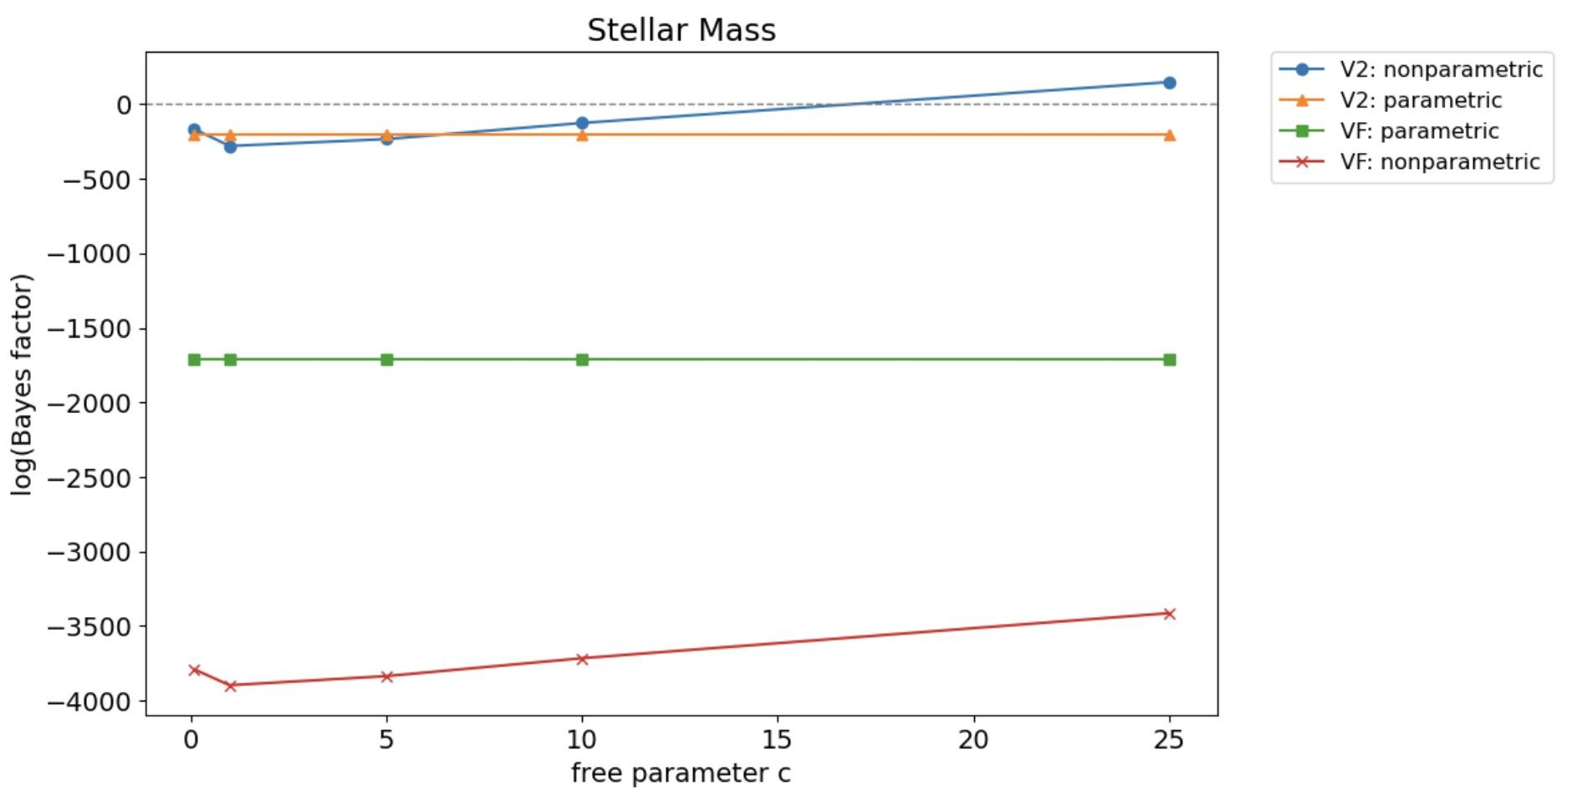
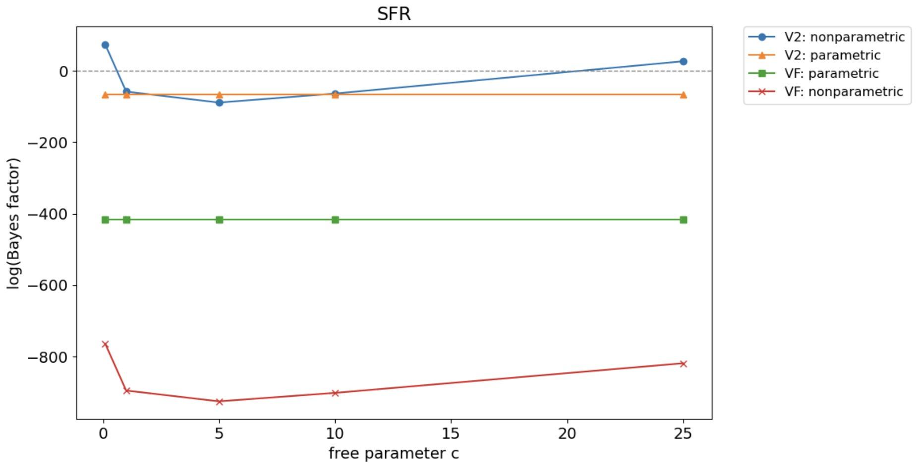
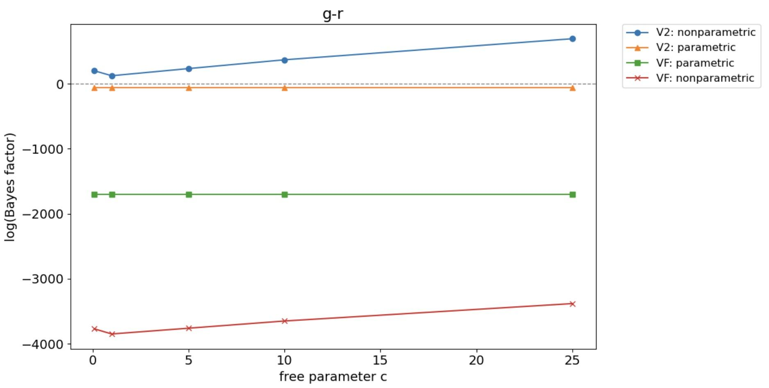
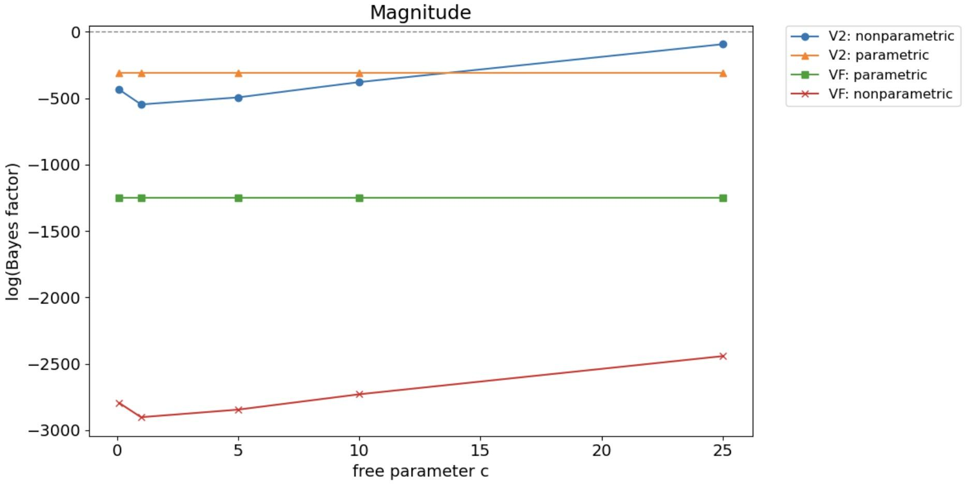
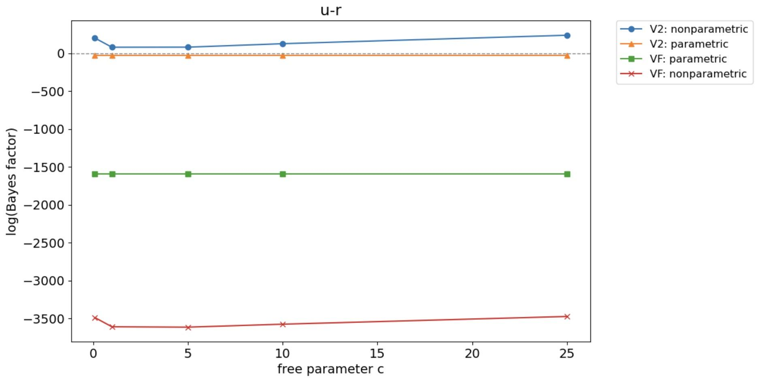
Effect of the free parameter 𝒄 when depth 𝒎 = 8

Slide 10
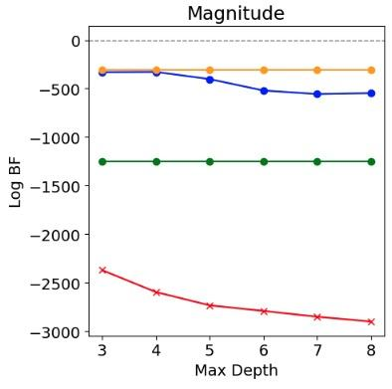
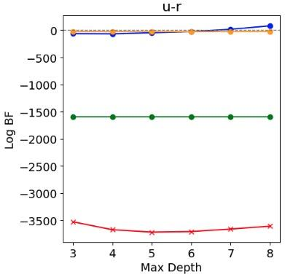
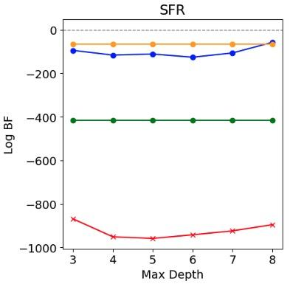
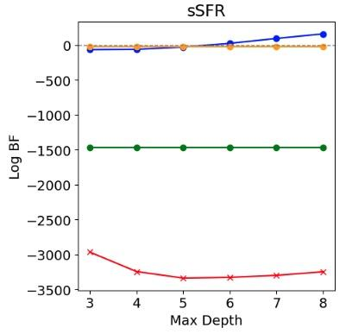
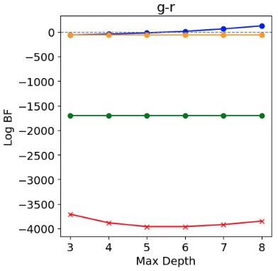
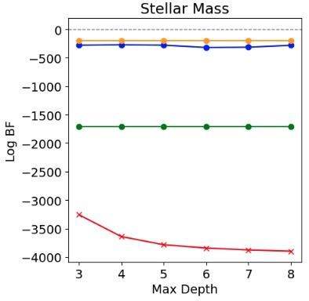
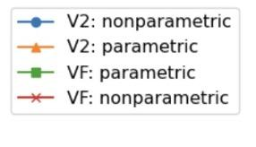
Effect of depth 𝒎 when we keep 𝒄 = 1

Slide 11
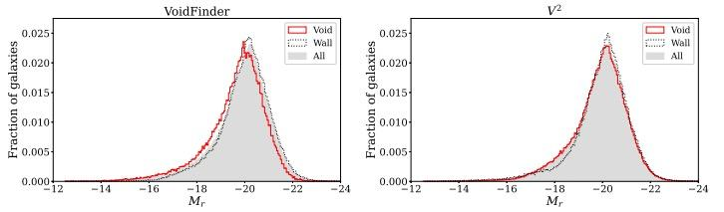
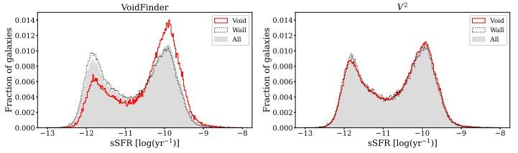
Conclusion
Log(Bayes factor) for various galaxy properties in our study (𝒄 = 1, 𝒎 = 8)
 | Stellar Mass | g-r | u-r | Magnitude | SFR | sSFR
𝐕𝐨𝐢𝐝𝐅𝐢𝐧𝐝𝐞𝐫 | -3896 | -3847 | -3608 | -2901 | -895 | -3247
𝐕² | -280 | 123 | 80 | -547 | -58 | 161

Slide 12
Conclusion
Using 𝐕², we observe little differences between the properties of void and wall galaxies, particularly regarding color distributions (g-r, u-r) and specific star formation rates sSFR.
Conversely, the 𝐕𝐨𝐢𝐝𝐅𝐢𝐧𝐝𝐞𝐫 catalog shows that the property distributions of void galaxies are significantly different from those in denser regions.

Slide 13
Thank You

